Slide 1
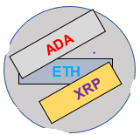
Cryptocurrency Predictor Model
By: Celsius Rebello, Brian Cha, Ted Accardi, Alberto R-G

Slide 2
Background/Purpose
Our model predicts the price of cryptocurrencies both 30 and 60 days in the future
Topic chosen based on world interest in Crypto investing and teams collective interest in cryptocurrency
Questions we hope to answer:
What will our model predict that the price of Cardano, Ethereum and Ripple will be at various points in the future?
How can we provide a basis for investing to the 30 day investor and the 60 day investor given crypt has high volatility? Is supervised learning the best option to tell us this?
Can we apply the same model to other cryptocurrencies? We have provided a subset of Ethereum, Cardano and Ripple
Will different cryptos with their different price volumes and differing real world utility behave similarly?

Slide 3
Tools / Methodology
Captured daily historical pricing of ADA, ETH and XRP dating back to 2017 from - https://coincodex.com/crypto/ethereum/historical-data/
Used supervised learning/linear regression to train and predict prices 30 and 60 days out from the last date of the historical data (4/26/2022)
Connected data to Postgres database via AWS RDS - for universal team access and true to distributed team working
Data source ddl is contained in - grp5_db_Tables_creation_crypto.sql
Extracted data from Postgres to visualize in Tableau

Slide 4
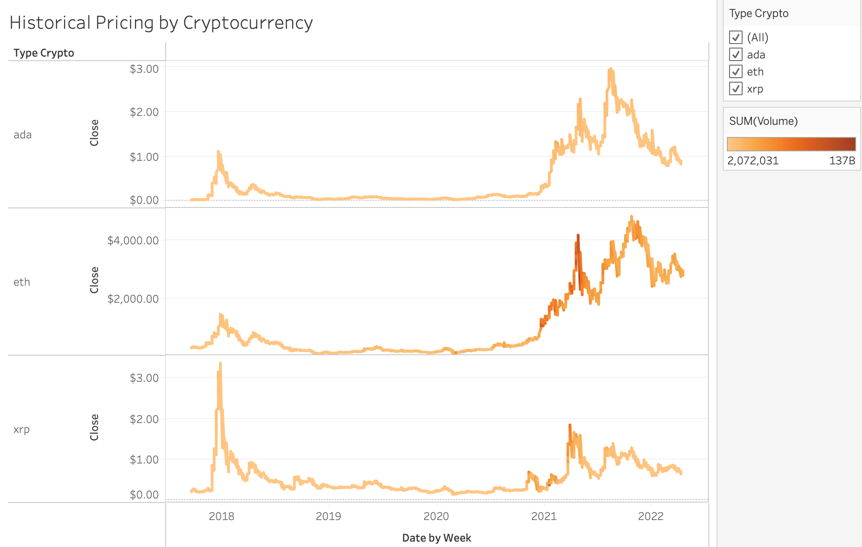
Historical Pricing

Slide 5
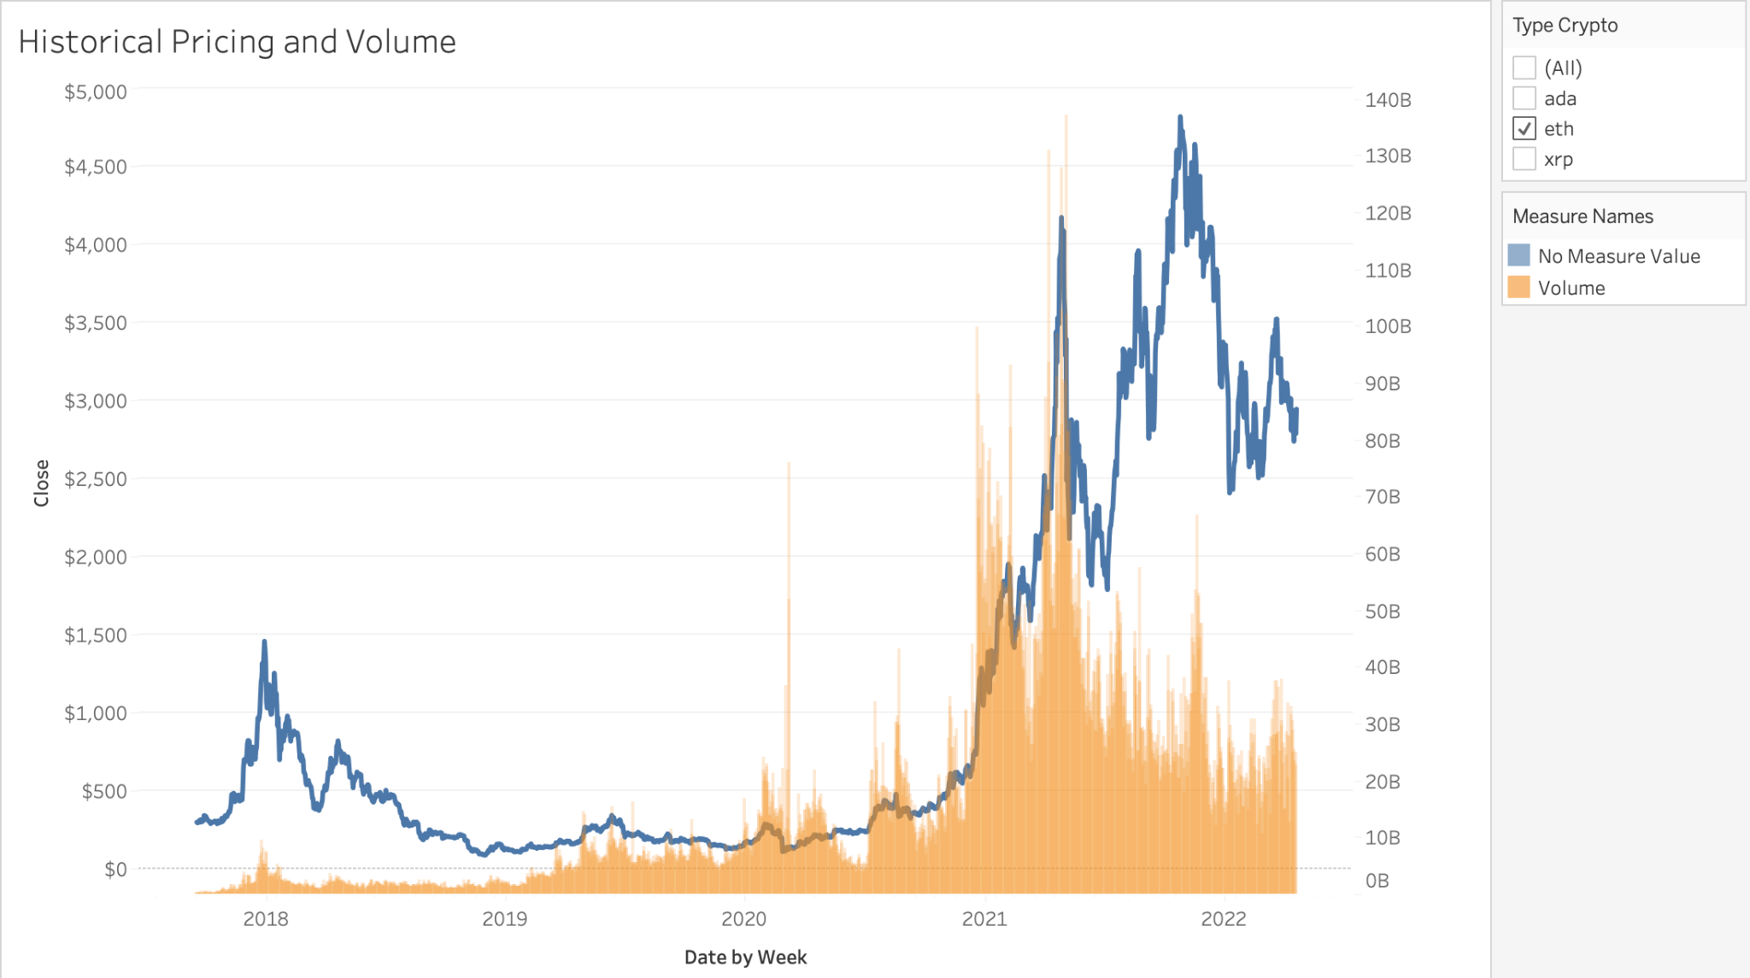
Historical Pricing (cont’d)

Slide 6
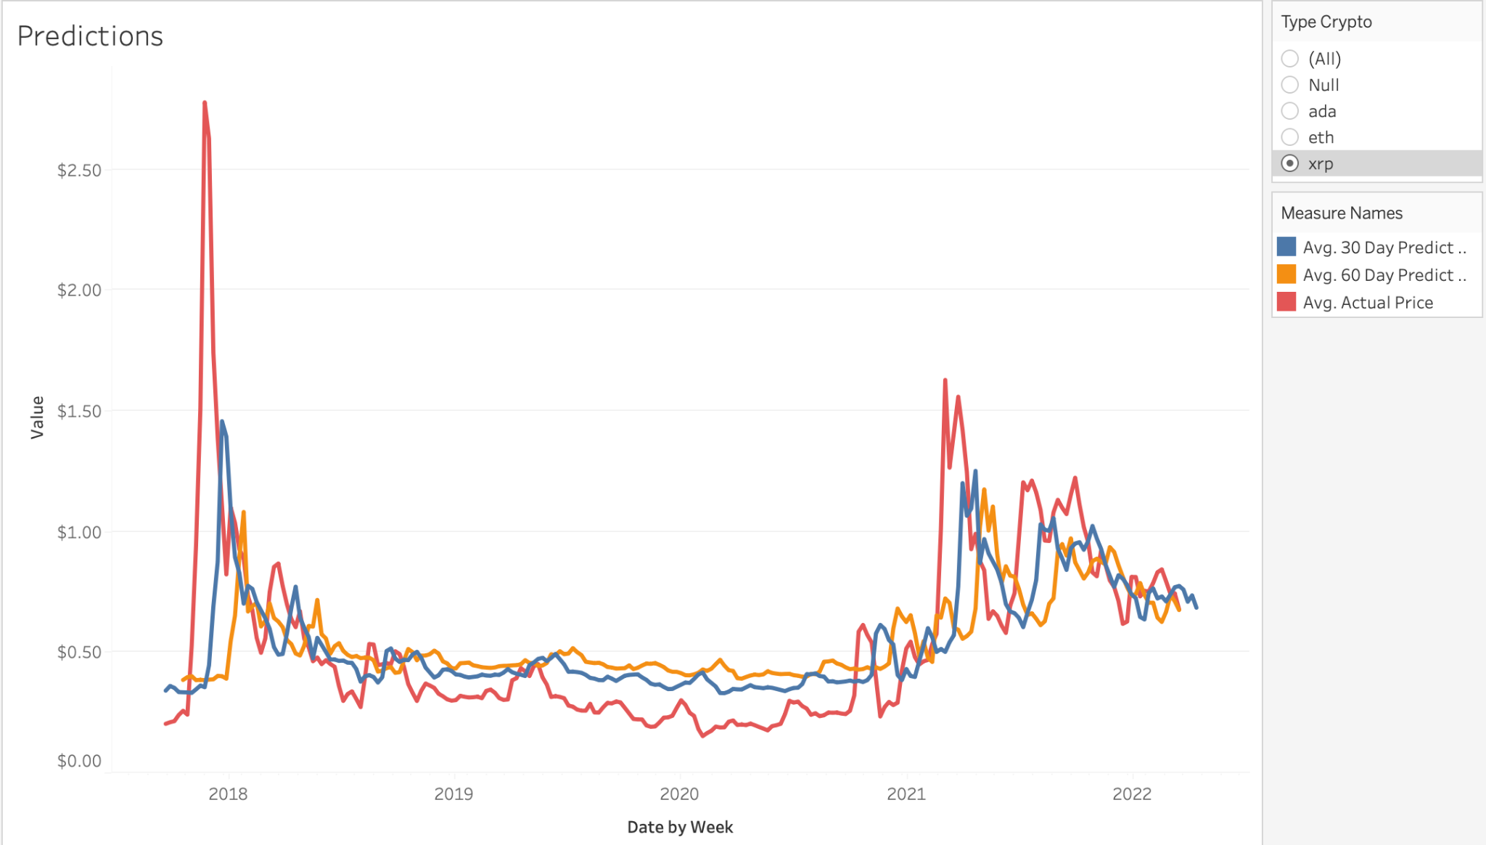
Prediction Models

